Slide 1
Transfer and transform data with Azure Data Factory or Azure Synapse Pipelines
Notes:
Instructor notes and guidance.
In this module, explain to the students that they will learn how Azure Data Factory/Synapse Pipelines can orchestrate large scale data movement by using other Azure Data Platform and Machine Learning technologies. Stress to the students that this enables them to take advantage of the capabilities of other Azure Data Platforms to manipulate data rather than using the built-in capabilities of Azure Data Factory/Azure Synapse Pipelines (ADF/ASP) including the copy activity and the mapping data flow covered in the previous modules.
The reason for taking this approach is varied. Some organization may already have data engineering investments in other technologies that they would like to take advantage of. It could be that Azure Data Factory/Azure Synapse Pipelines does not have the capabilities that are required within the pipeline. At a simple level, you may have a team of data engineers that simply have a preference for using a specific technology. Regardless of the reason, this module explores how you can take advantage of Azure Data Factory/Azure Synapse Pipelines to orchestrate the pipeline that involves other Data Platform technologies. As a result, you need to be familiar with the Azure Data Factory/Azure Synapse Pipelines Control Flow component and how parameters can be used within them.
Share with the students that Azure Data Factory/Azure Synapse Pipelines can work with a wide variety of data platform technologies from Azure Machine Learning through to Azure Functions. In this module and the associate lab, share that you will explore how we can orchestrate notebooks as that is a common tool used by data engineering.

Slide 2
Agenda
Perform code-free transformations with Azure Data Factory or Azure Synapse Pipelines
Build Azure Data Factory or Azure Synapse Analytics Pipelines
Notes:
TALKING POINTS
Let’s set an agenda for today’s presentation in which we are going to discuss the following:
Integrate data from Notebooks with Azure Data Factory or Azure Synapse Pipelines
PRESENTER NOTES AND GUIDANCE
Don’t take too much time in order to present the agenda. Make the points in the topics.

Slide 3
Perform code-free transformations at scale with Azure Synapse Pipelines
1

Slide 4
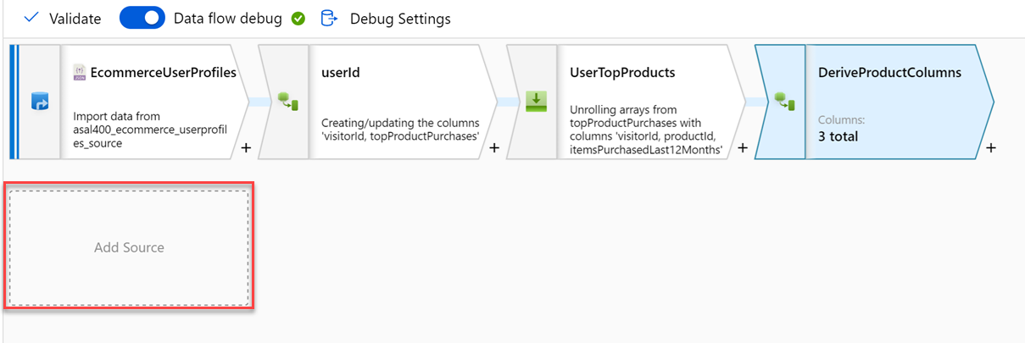
Code-free transformation at scale with Azure Data Factory or Azure Synapse Pipelines
Notes:
Talking points
Let’s dive into the data flow mapping
Mapping data flows are visually designed data transformations in Azure Data Factory or Azure Synapse Pipelines.
Data flows allow data engineers to develop graphical data transformation logic without writing code.
The resulting data flows are executed as activities within Azure Data Factory/Synapse pipelines that use scaled-out Spark clusters.
Data flow activities can be operationalized via existing Data Factory/Synapse Pipeline scheduling, control, flow, and monitoring capabilities. Mapping data flows provide a fully visual experience with no coding required.
Your data flows will run on your own execution cluster for scaled-out data processing. Azure Data Factory/Synapse handles all the code translation, path optimization, and execution of your data flow jobs.
Data Flow mapping brings the following benefits and capabilities:
- Perform data cleansing, transformation, aggregations, etc.
- Enables you to build resilient data flows in a code free environment
- Enable you to focus on building business logic and data transformation
- The underlying infrastructure is provisioned automatically with cloud scale via Spark execution
Like many data transformation tools, Mapping Data Flow in Azure Data factory supports a great variety of data transformations.
Recommended reading for this slide
Code-free transformation at scale with Azure Data Factory - Learn | Microsoft Docs

Slide 5
Building Azure Data Factory or Azure Synapse Pipelines
2
Notes:
TALKING POINTS
Let’s go over integration data from Notebooks with Azure Data Factory or Azure Synapse Pipelines.
PRESENTER NOTES AND GUIDANCE
N/A.

Slide 6
What is Azure Data Factory?
Cloud-based ETL and data integration service
Service to orchestrate and operationalize data movement and ingestion processes
Allows you to create data-driven workflows for orchestrating data movement and transforming data at scale
Ingest data from disparate data stores
Build complex ETL/ELT processes for transforming data
Notes:
In the world of big data, raw, unorganized data is often stored in relational, non-relational, and other storage systems. However, on its own, raw data doesn't have the proper context or meaning to provide meaningful insights to analysts, data scientists, or business decision makers.
Big data requires a service that can orchestrate and operationalize processes to refine these enormous stores of raw data into actionable business insights. Azure Data Factory is a managed cloud service that's built for these complex hybrid extract-transform-load (ETL), extract-load-transform (ELT), and data integration projects.
Azure Data Factory is the platform that solves such data scenarios.

Slide 7
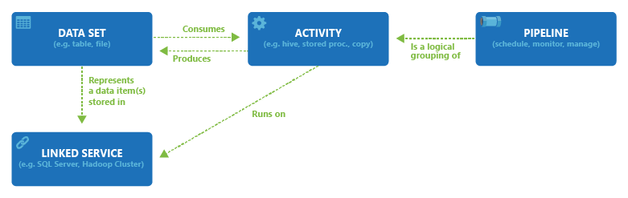
ADF Terminology
Linked Services
Data Sets
Activities
Pipelines
Integration Runtimes
Notes:
Linked Services: Link a data store to Azure Data Factory or Synapse Pipelines. Very much link connection strings. They define the connection information needed for the service to connect to external references.
Data sets: A data set is a named view of data that simply points or reference the data you want to use in your activities.
Activities: Define the actions to perform on your data.
Pipelines: Logical grouping of activities that together perform a task

Slide 8


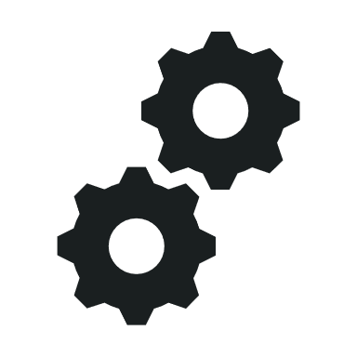




Understand pipelines
  Pipelines encapsulate a flow of activities that are orchestrated by an integration runtime
  Activities can include:
    Data movement and data transformation activities that transfer data from sources to sinks
    External processing activities
    Control flow activities that manage variables and processing logic
  Linked services provide access to data stores and processing platforms where activities can
  be run
  The data processed in a pipeline is defined in datasets, accessed through linked services
Data Flow activity
Source
Transformation
Sink
Pipeline
Dataset
Activities
Dataset
Linked services
Integration runtime
Notes:
Use the diagram on the slide to show the conceptual architecture:
Pipelines consist of activities. They’re listed in the Integrate page in Azure Synapse Studio.
The overall pipeline, including control flow, data flow, and orchestration of activities on linked services is managed in an integration runtime.
Activities can encapsulate data flows (copying and transforming data), call external services, or they can implement control flow logic (loops, branches, variable assignment, and so on)
Linked services are connections to compute resources on which activities can run or datasets can be read/written
Datasets encapsulate data that is passed through the pipeline and can serve as inputs and outputs for activities..
Datasets and linked services can be reused by multiple pipelines. They’re listed in the Data and Manage pages in Azure Synapse Studio.
Pipelines in Azure Synapse Analytics are based on the same technology and user experience as Azure Data Factory. For details of differences between thee two services, see https://learn.microsoft.com/azure/synapse-analytics/data-integration/concepts-data-factory-differences.

Slide 9
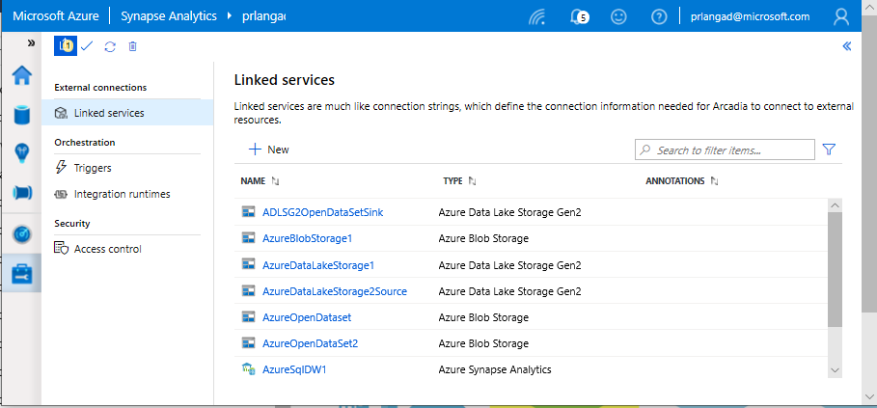
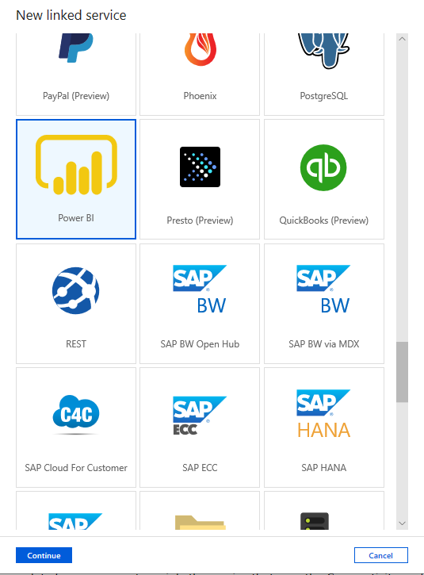
Linked services
Overview
Linked services define the connection information needed to connect to external resources.
Benefits
Offers pre-built 95+ connectors
Easy cross-platform data migration
Represents data store or compute resources

Slide 10
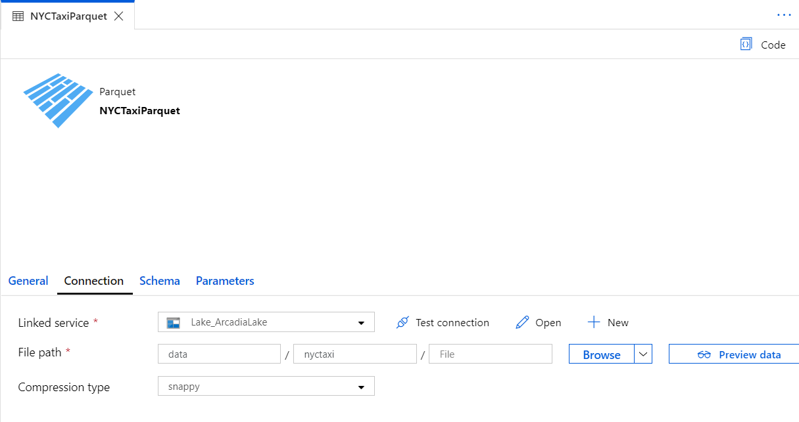
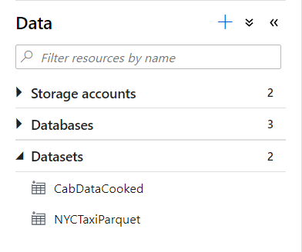
Datasets
Orchestration datasets describe data that is persisted.
Once a dataset is defined, it can be used in pipelines and sources of data or as sinks of data.

Slide 11
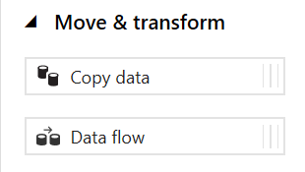
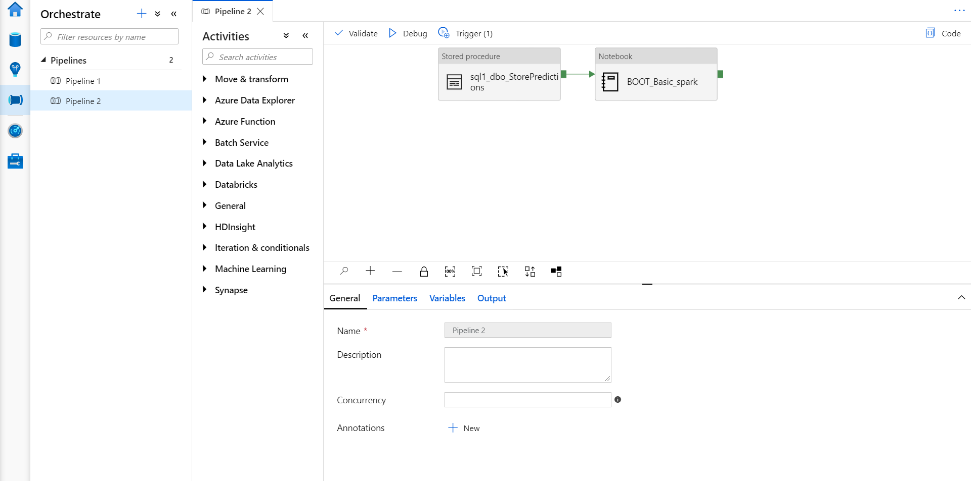
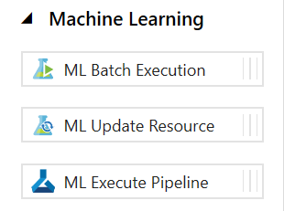
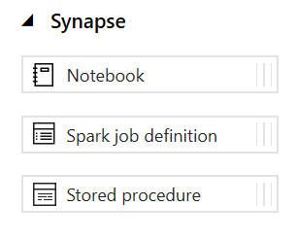
Pipelines
Notes:
Create pipelines to ingest, transform and load data with 95+ inbuilt connectors.
Pipelines offer a wide range of activities that they can perform.
They provide ability to load data from a storage account or other connectors to the desired linked service.
You can load data by manual execution of the pipeline or by orchestration.
Benefits
Pipelines support common loading patterns and provide fully parallel loading into the data lake or SQL tables.
All of this is done through a graphical development experience.

Slide 12
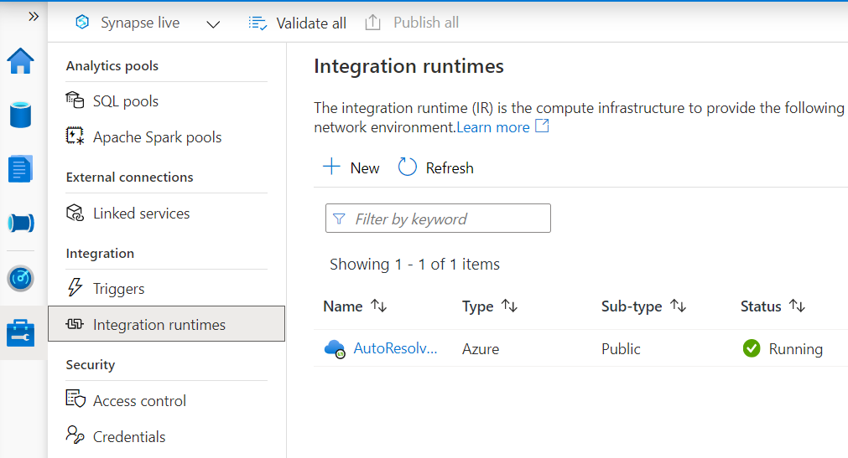
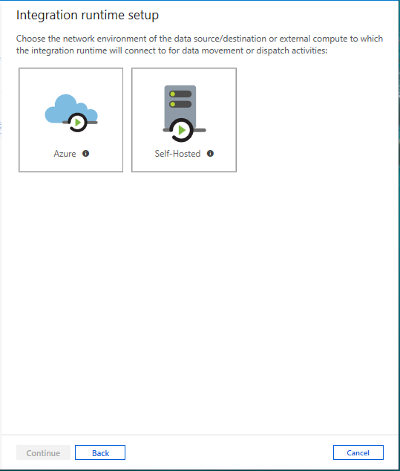
Integration runtimes
Overview
Integration runtimes are the compute infrastructure used by Pipelines to provide the data integration capabilities across different network environments. An integration runtime provides the bridge between the activity and linked services.
Benefits
Offers Azure Integration Runtime or Self-Hosted Integration Runtime
Azure Integration Runtime – provides fully managed, serverless compute in Azure
Self-Hosted Integration Runtime – use compute resources in on-premises machine or a VM inside private network
Notes:
Need to explain and why needed
Check with Gaurav

Slide 13
Comparing Azure Data Factory with Synapse Pipelines
Azure Data Factory
Synapse Pipelines
Allows use of SSIS and SSIS Integration Runtime and SSIS package activity
Supports Cross-region Integration Runtime (Data Flows)
Integration Runtime sharing across different data factories
Provides support for Power Query Activity
Support for global parameters in pipeline activities
Synapse now supports SSIS for loading data into a dedicated SQL pool
Monitoring of Spark jobs for Data Flows leveraging Synapse Spark pools
Notes:
TALKING POINTS
Before looking at petabyte-scale ingestion, lets quickly compare Azure Data Factory with Synapse Pipelines. ADF and Synapse Pipelines are essentially the same product, and they share the same code base. However, there are a few differences you should be aware of, most notably that Synapse Pipelines does not allow the use of the SSIS Integration Runtime.
PRESENTER NOTES AND GUIDANCE
Review:
https://docs.microsoft.com/en-us/azure/synapse-analytics/data-integration/concepts-data-factory-differences

Slide 14
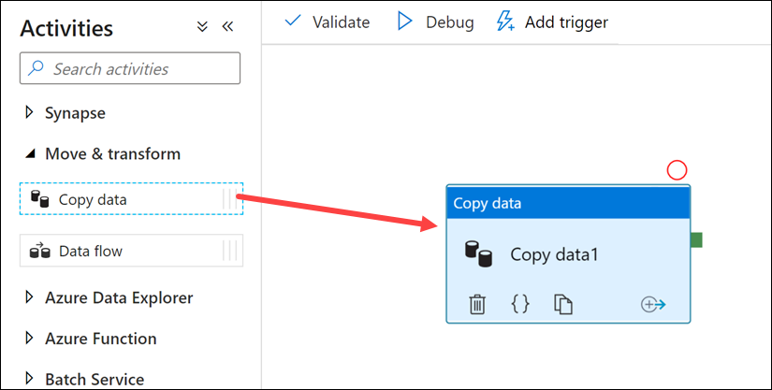
Petabyte-scale ingestion with the Copy data activity
Notes:
Talking points
The Copy Data Activity provides a method for building code-free data ingestion pipelines that do not require any transformation during the extraction of the data. The Copy Activity has support for over 100 native connectors. This method can suit new start-up projects that have a simple method of extraction to an intermediary data store. An example of ingesting data using the Copy Activity can include extracting data from multiple source database systems and outputting the data to files in a data lake store.
The Copy activity performs the following steps:
Reads data from a source data store.
Performs serialization/deserialization, compression/decompression, column mapping, and so on. It performs these operations based on the configuration of the input dataset, output dataset, and Copy activity.
Writes data to the sink/destination data store
Instructor notes and guidance.
You may want to consider running a simple demo of the copy activity yourself to show how to setup the copy activity in Azure Data Factory/Azure Synapse pipelines. Inform the students that they will get to explore the Copy Activity in exercise 2 of the lab.
Recommended reading for this slide
Use data loading best practices in Azure Synapse Analytics - Learn | Microsoft Docs

Slide 15
PolyBase vs COPY
PolyBase
COPY
  Relaxed permission
  No row width limit
  Supports delimiters in text
  Supports custom column and row delimiters
  GA, stable
  Needs CONTROL permission
  Enables querying via external tables
  Challenges:
    Row width (1 MB)
    Delimiters in text
    Fixed line delimiter
    Code complexity
Notes:
To use PolyBase, the user that loads data into Azure Synapse Analytics must have "CONTROL" permission on the target database. One way to achieve that is to add the user as a member of the db_owner role
PolyBase loads are limited to rows smaller than 1 MB. It cannot be used to load to VARCHR(MAX), NVARCHAR(MAX), or VARBINARY(MAX).

Slide 16
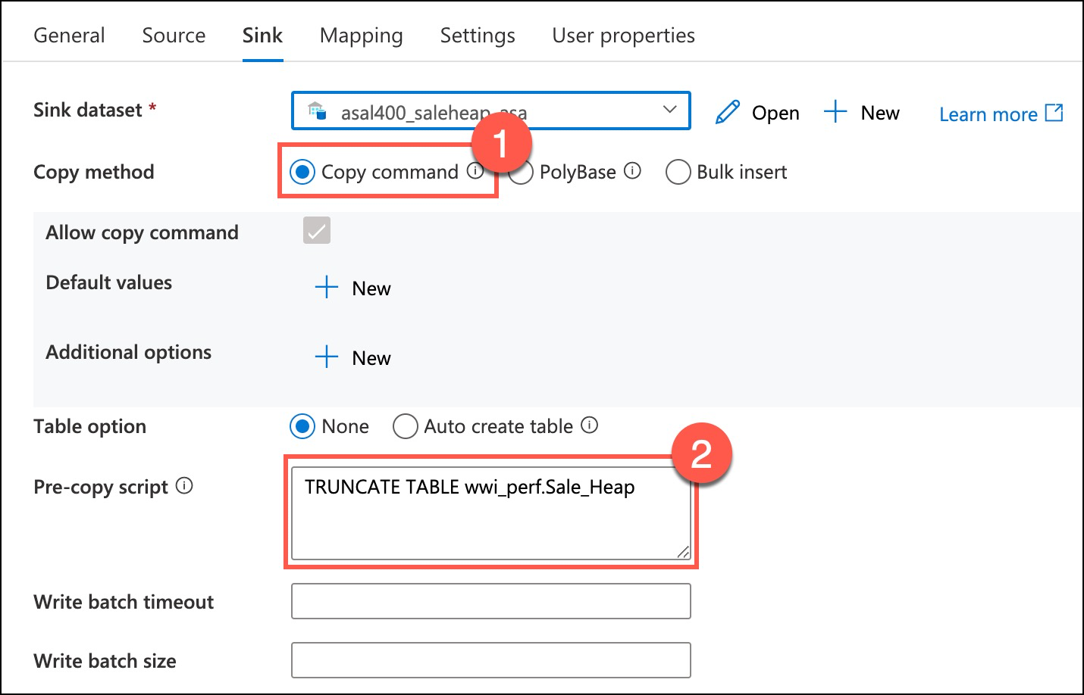
Copy Activity

Slide 17
Integrate data from Notebooks with Azure Data Factory or Azure Synapse Pipelines
3

Slide 18
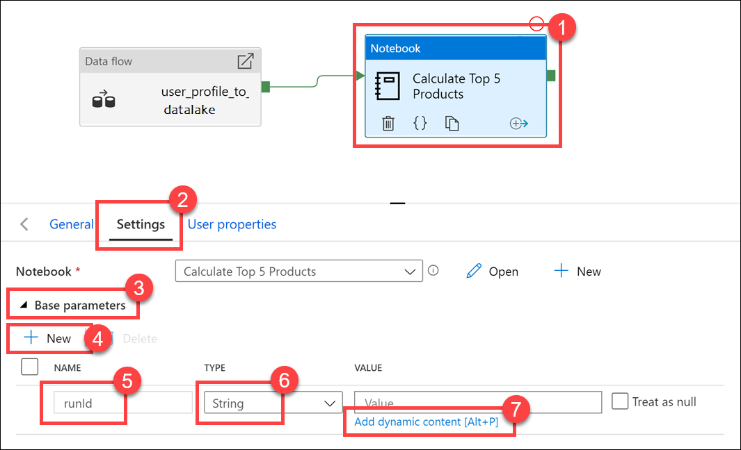
The Synapse pipeline notebook activity can send parameters to the notebook.
Notice the name of runId matches the name of the parameter variable used in the parameter cell.

Slide 19
LAB 10: Build a data pipeline in
Azure Synapse Analytics
60 minutes
Notes:
TALKING POINTS​
​
Let’s put this into reality and show you how it works.​
​In the lab, the students will create a notebook to query user activity and purchases that they have been made in the past 12 months. They will then add the notebook to a pipeline using the new Notebook activity and execute this notebook after the Mapping Data Flow as part of their orchestration process. While configuring this, the students will implement parameters to add dynamic content in the control flow and validate how the parameters can be used.
In exercise 1 of this lab, the students will create a notebook, and there is an argument that this exercise is not relevant to the objective of the module which would be a fair comment. As a development team, we decided to keep this exercise on the basis that we received overwhelming feedback from MCTs that they wanted the course to have each module independent from each other. As a result, exercise 1 has been retained so that you can teach this module in isolation so that the students understand exactly what the notebook is doing, and how the parameter in the notebook will be used in exercise 2. Furthermore, it has removed a dependency on teaching Module 5 and 6 should you wish to tailor the course.
By creating the notebook in exercise 1, they then manage the orchestration of this notebook in an existing pipeline in exercise 2. This allows students to experience working with control flow, managing the flow and working with parameter to add dynamic capabilities to the pipelines that are built. The students will then execute the pipeline that they have modified with this orchestration to view the impact of the work that they create. It’s important to reinforce to the students the regular use of parameters in enterprise grade ETL solutions.

